Slide 1
Project management in new masters’ curriculum
PhD Asya Stoyanova –Doycheva
University of Plovdiv, Bulgaria

Slide 2
Introduction - Masters’ program scheme

Slide 3
Challenges
80 students;
Teacher staff is too limited - 1 Prof. and 4 assistants prof.;
Face to face consultation only in weekends.

Slide 4
Project’s organization strategy
Prepare projects’ requirements in principle
Form collaborative working groups
Teams makes proposals for projects by themselves
Teachers makes projects proposals for “non creative teams”
Consultations
Final product presented for all teams
Team work -encourage students to work in teams
Diversity - each team is working on different project and possibly different technology
Knowledge sharing - the resulting artifacts are available for all teams
Using DeLC tools for distant organization of the work
Notes:
Принципите, които са залегнали в нашата стратегия са:
поощрява се образуването на екипи от поне двама човека
цели се разнообразие в разработваните проекти за да се предизвика взаимен интерес между различните екипи
постигнатите резултати са достъпни за всички екипи за да се подобри разпространението на знания и да се постигне някакво ниво на самооценка
използване на средства, които позволяват организационните въпроси да се решават дистанционно и по този начин да се минимизират ненужните срещи с преподавателите

Slide 5
Projects’ Requirements
Teachers prepare principle projects requirements and set parameters for completing the projects
These requirements are published in DeLC.
Prepare projects’ requirements in principle
Form collaborative working groups
Teams makes proposals for projects by themselves
Teachers makes projects proposals for “non creative teams”
Consultations
Final product presented for all teams

Slide 6
Projects’ Requirements
The teachers prepare projects requirements in principle and set parameters for completing the projects
These requirements are published in DeLC.
Prepare projects’ requirements in principle
Form collaborative working groups
Teams makes proposals for projects by themselves
Teachers makes projects proposals for “non creative teams”
Consultations
Final product presented for all teams
The project must fulfill the following requirements:
Using of backend data. By example
Database server (MS SQL, MySQL, Oracle, PostgreSQL, Firebird, …)
Data streams (files, sockets, …)
WebServices (SOAP, XML-RPC, …)
Has graphical user interface (GUI)
Take care for the security issues
No limits for the implementation technology (it is recommended to be one of the used in the educational materials in the masters’ program)

Slide 7
Projects’ Requirements
The teachers prepare projects requirements in principle and set parameters for completing the projects
These requirements are published in DeLC.
Prepare projects’ requirements in principle
Form collaborative working groups
Teams makes proposals for projects by themselves
Teachers makes projects proposals for “non creative teams”
Teacher consultations
Final product presented for all teams
The project must fulfill the following requirements:
Using of backend data. By example
Database server (MS SQL, MySQL, Oracle, PostgreSQL, Firebird, …)
Data streams (files, sockets, …)
WebServices (SOAP, XML-RPC, …)
Has graphical user interface (GUI)
Take care for the security issues
No limits for the implementation technology (it is recommended to be one of the used in the educational materials in the masters’ program)
The project completes with defend.
Notes:
Проекта завършва с представянето му пред всички студенти от магистърската програма. По време на представянето могат да бъдат задавани въпроси към разработчиците, което спомага разпространението на знания.

Slide 8
Form collaborative working groups
Students are highly encouraged to form teams by their own discretion.
Teams should consists of 1 to 3 persons.
Prepare projects’ requirements in principle
Form collaborative working groups
Teams makes proposals for projects by themselves
Teachers makes projects proposals for “non creative teams”
Consultations
Final product presented for all teams

Slide 9
Projects’ proposals
The teams are encouraged to makes proposals for projects by themselves obeying the defined requirements.
These proposals are clarified with the teachers to produce the final project description.
Prepare projects’ requirements in principle
Form collaborative working groups
Teams makes proposals for projects by themselves
Teachers makes projects proposals for “non creative teams”
Consultations
Final product presented for all teams
Notes:
Дефинирането на задания за проекти от самите екипи предполага, че темата на проекта ще е интересна за смият екип, което би трябвало да повиши мотивацията на студентите да работят по задачите свързани с проекта.

Slide 10
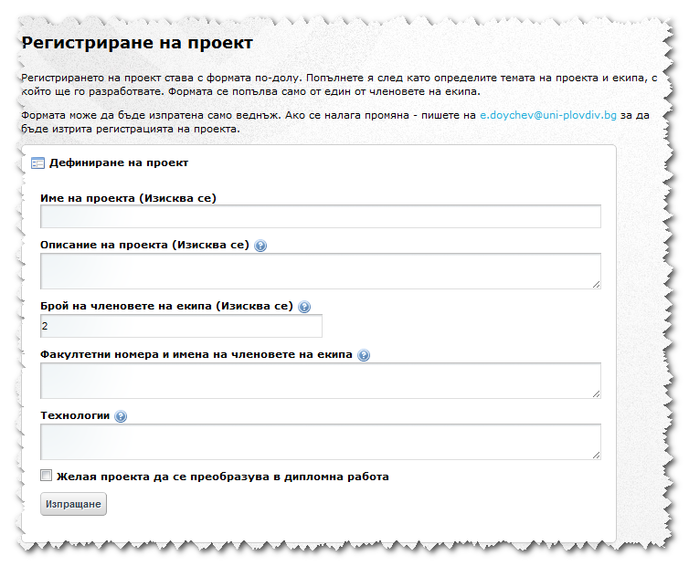
Projects’ proposals
Project proposal registration form available in DeLC
The teams are encouraged to makes proposals for projects by themselves obeying the defined requirements.
These proposals are clarified with the teachers to produce the final project description.
Prepare projects’ requirements in principle
Form collaborative working groups
Teams makes proposals for projects by themselves
Teachers makes projects proposals for “non creative teams”
Teacher consultations
Final product presented for all teams
Project’s title
Project ‘s description
Number of team members
Team members IDs
Implementation technologies
Notes:
Дефинирането на задания за проекти от самите екипи предполага, че темата на проекта ще е интересна за смият екип, което би трябвало да повиши мотивацията на студентите да работят по задачите свързани с проекта.

Slide 11
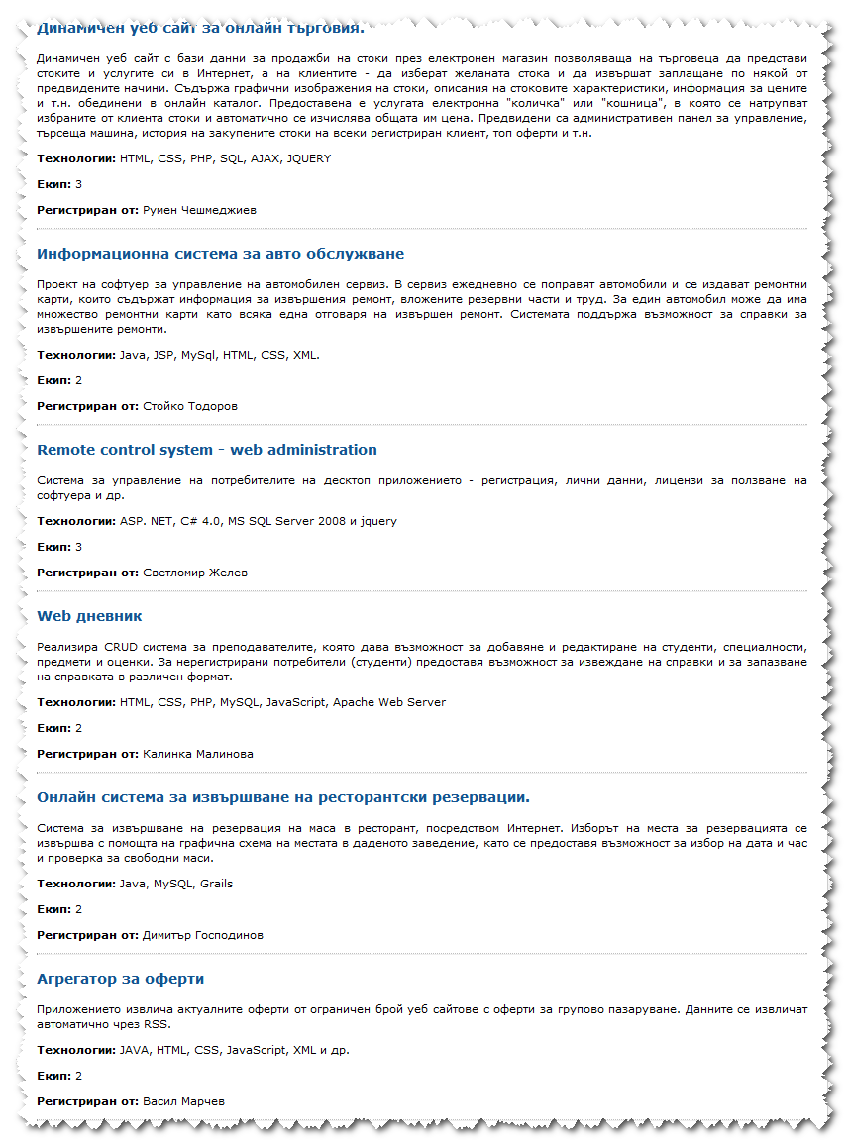
Projects’ proposals
Total of 43 registered projects
The teams are encouraged to makes proposals for projects by themselves obeying the defined requirements.
These proposals are clarified with the teachers to produce the final project description.
Prepare projects’ requirements in principle
Form collaborative working groups
Teams makes proposals for projects by themselves
Teachers makes projects proposals for “non creative teams”
Consultations
Final product presented for all teams
Notes:
Дефинирането на задания за проекти от самите екипи предполага, че темата на проекта ще е интересна за смият екип, което би трябвало да повиши мотивацията на студентите да работят по задачите свързани с проекта.

Slide 12
Non-creative Teams?
The teachers’ work is to define projects only for the teams, which can not propose reasonable one.
Prepare projects’ requirements in principle
Form collaborative working groups
Teams makes proposals for projects by themselves
Teachers makes projects proposals for “non creative teams”
Consultations
Final product presented for all teams
Notes:
Преподавателите дефинират задания за проекти за екипите, които не могат да предложат смислено такова. По този начин се облегчава работата на преподавателите.

Slide 13
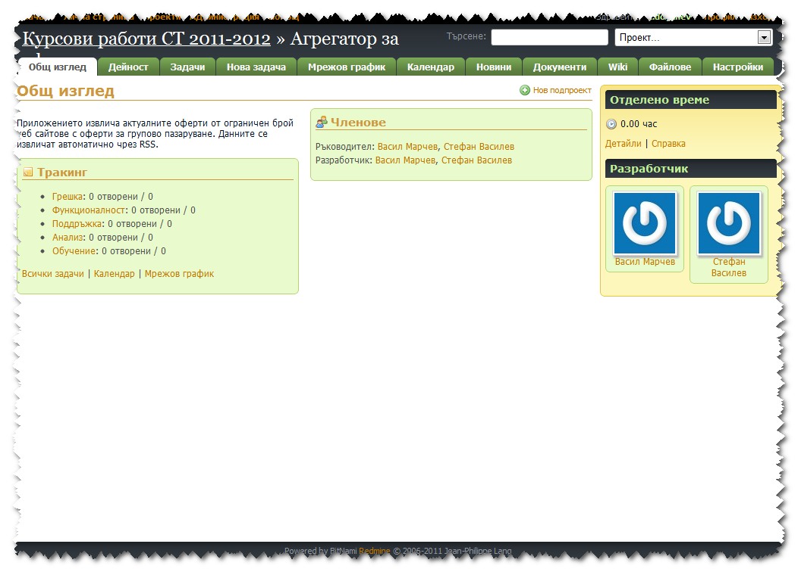
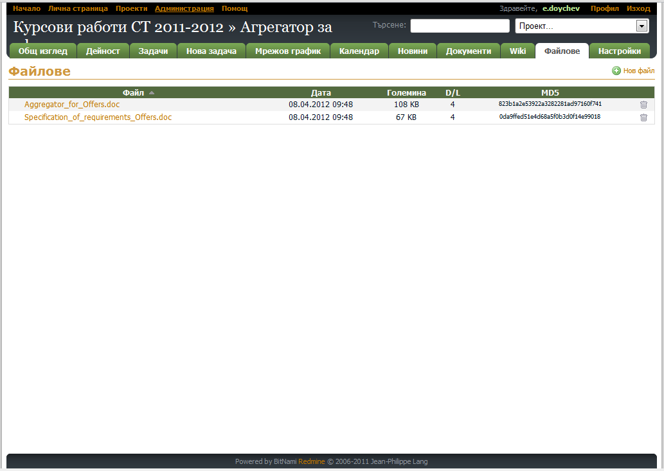
Non-creative Teams?
The teachers’ work become lighter as they need to define projects only for the teams, which cannot propose reasonable one.
Prepare projects’ requirements in principle
Form collaborative working groups
Teams makes proposals for projects by themselves
Teachers makes projects proposals for “non creative teams”
Teacher consultations
Final product presented for all teams
Notes:
След определяне на темата на всеки проект се прави регистрация на проекта в системата за управление на проекти Redmine, която е инсталирана като подсистема в DeLC. Това позволява по-ефективно управление на всеки проект и подобрява взаимодействието между членовете на екипа и преподавателите.

Slide 14
Consultations
Consultations are made on predefined dates (11 possibilities).
The teams are encouraged to register for a consultation in the week before each consultation date only if they intend to participate.
The teachers know in advance how many teams will participate in the consultation and what topics they need help.
Prepare projects’ requirements in principle
Form collaborative working groups
Teams makes proposals for projects by themselves
Teachers makes projects proposals for “non creative teams”
Consultations
Final product presented for all teams
Notes:
Предварително са дефинирани 11 дати за консултации. В рамките на една седмица преди всяка дата екипите, които имат нужда от консултация се регистрират. По този начин преподавателите знаят предварително колко екипа ще присъстват на консултациите и по какви теми ще имат нужда от помощ.

Slide 15
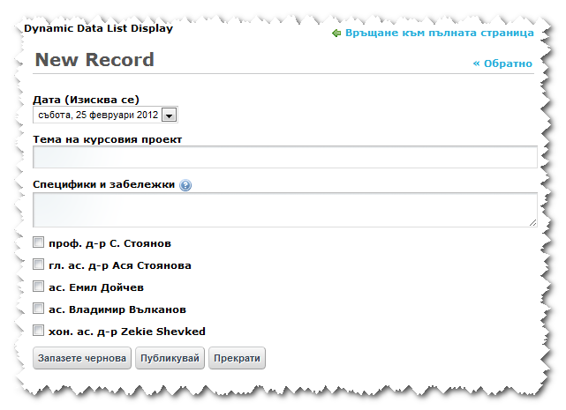
Consultations
Registration form for consultation available in DeLC
Consultations are made on predefined dates (11 possibilities).
The teams are encouraged to register for a consultation in the week before each consultation date only if they intend to participate.
The teachers know in advance how many teams will participate in the consultation and for what topics they need help.
Prepare projects’ requirements in principle
Form collaborative working groups
Teams makes proposals for projects by themselves
Teachers makes projects proposals for “non creative teams”
Teacher consultations
Final product presented for all teams
Consultation date
Project title
Problem description or desired topic
Specific teacher (optional)
Notes:
Предварително са дефинирани 11 дати за консултации. В рамките на една седмица преди всяка дата екипите, които имат нужда от консултация се регистрират. По този начин преподавателите знаят предварително колко екипа ще присъстват на консултациите и по какви теми ще имат нужда от помощ.

Slide 16
Project Defend
Project defends are public for all students in the masters’ program.
The procedure is not in formal form.
Questions from teachers and students are allowed.
The final grade is for the whole team, but it is valid for each student in the team individually.
Prepare projects’ requirements in principle
Form collaborative working groups
Teams makes proposals for projects by themselves
Teachers makes projects proposals for “non creative teams”
Consultations
Final product presented for all teams
Notes:
Защитата на проекта включва и демонстрация на разработения продукт.

Slide 17
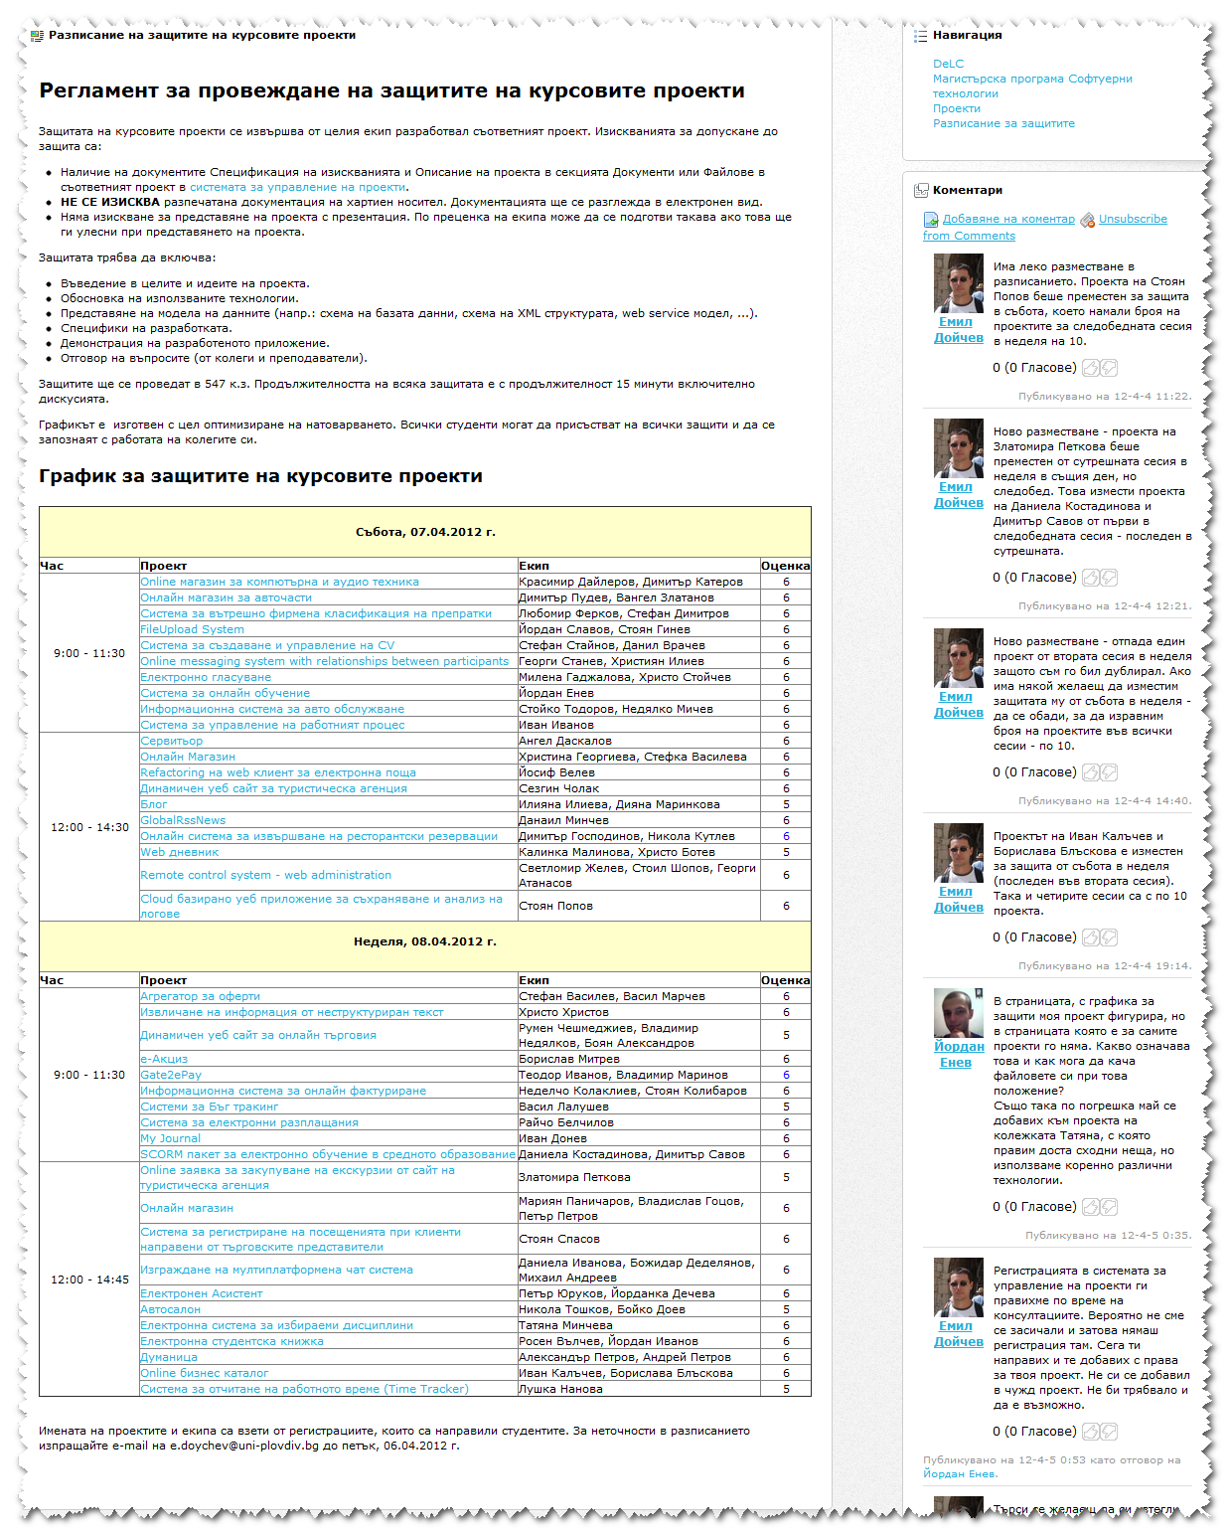
Project Defend
Organization of the projects defend and two days schedule for the teams
Project defends are public for all students in the masters’ program.
The procedure is in not formal form.
Questions from teachers and students are allowed.
The final grade is for the whole team, but it is valid for each student in the team individually.
Prepare projects’ requirements in principle
Form collaborative working groups
Teams makes proposals for projects by themselves
Teachers makes projects proposals for “non creative teams”
Consultations
Final product presented for all teams
Notes:
Защитата на проекта включва и демонстрация на разработения продукт.

Slide 18
Projects’ Topics
Topic | Count of projects
e-learning | 6
e-commerce | 15
e-government | 1
in-house systems | 8
messaging systems | 3
news publishing and aggregation | 4
other | 4

Slide 19
Used Technologies
Technology | Number of projects
Java | 17
Grails | 2
.Net | 12
PHP | 9

Slide 20
Students’ feedback
They learn more
They understand more
They like this form of education more

Slide 21
Conclusions
Big load of work for the teachers;
Without support of the DeLC tools it would be difficult;
Unlimited development technologies are problem.

